Slide 1
DIVISION ALGORITHM
GROUP 9

Slide 2
GROUP MEMBERS
- Ojo OREOLUWA – 2201110004
- AJANI SEYI – 2101120005
- TANIMOWO EMMANUEL - 2101110048

Slide 3
What is division algorithm?
The division algorithm refers to the process by which a computer or microprocessor performs division operations. Division is a fundamental arithmetic operation that involves finding the quotient of two numbers (dividend and divisor).

Slide 4
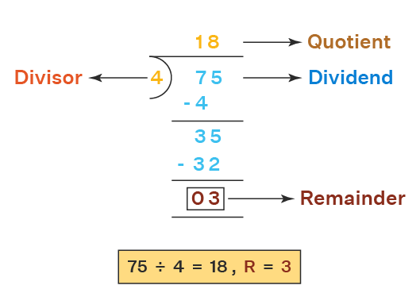
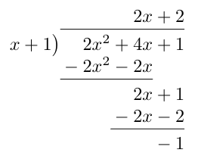
Types of division algorithm
Long Division Algorithm
Long division is a basic algorithm where you divide the digits of the dividend by the divisor, working from left to right.

Slide 5
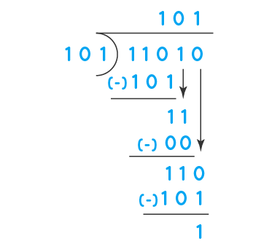
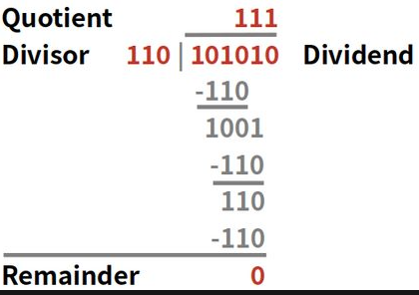
Types of division algorithm
Binary Division Algorithm
Similar to long division, but adapted for binary numbers.

Slide 6
Types of division algorithm
Restoring Division Algorithm
Uses restoring steps to bring the remainder back into alignment with the divisor.

Slide 7
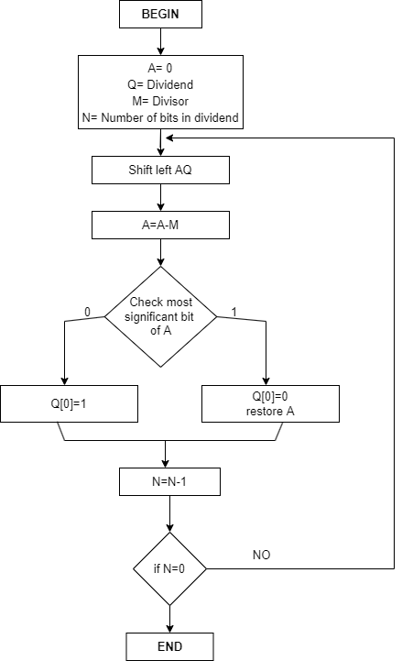

Slide 8
Restoring Division Algorithm
11(Dividend)/3(Divisor)=3(Quotient) and 2(Remainder)
n M A Q Action
4 00011 00000 1011 Initialization
00001 011_ SL AQ
11110 011_ A = A-M
3 00001 0110 Q[0] = 0 RestoreA
00010 110_ SL AQ
11111 110_ A = A-M
2 00010 1100 Q[0]=0 RestoreA
00010 100_ SL AQ
00010 100_ A = A-M
1 00010 1001 Q[0]=1
00101 001_ SL AQ
00010 001_ A=A-M
0 00010 0011 Q[0] = 1

Slide 9
Types of division algorithm
Non-Restoring Division Algorithm
Avoids restoring steps, leading to faster computation.

Slide 10
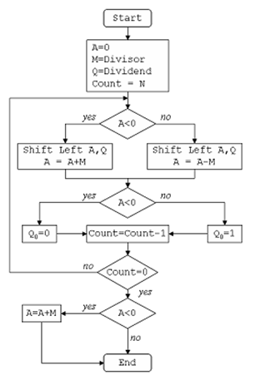

Slide 11
Non Restoring Division
11(Dividend)/3(Divisor) = 3(Quotient) and 2(Remainder)
n M A Q Action
4 00011 00000 1011 INITIALIZATION
00001 011_ SL AQ
11110 011_ A = A-M
3 11110 0110 Q₀ =0
11100 110_ SL AQ
11111 110_ A = A+M
2 11111 1100 Q₀ = 0
11111 100_ SL AQ
00010 100_ A = A+M
1 00010 1001 Q₀ = 1
00101 001_ SL AQ
00010 001_ A = A-M
0 00010 0011 Q₀ = 1

Slide 12
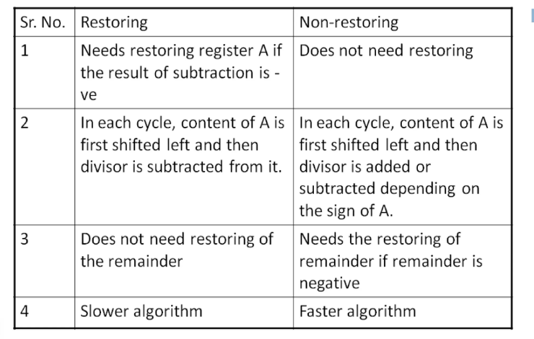
Differences between restoring & non-restoring algorithm

Slide 13
CONCLUSION
In conclusion, division algorithms are fundamental processes in computer architecture used to efficiently perform division operations.
Long Division Algorithm: Basic method for dividing digits from left to right.
Binary Division Algorithm: Adaptation for binary numbers.
Restoring Division Algorithm: Uses restoring steps to align remainder with divisor.
Non-Restoring Division Algorithm: Avoids restoring steps for faster computation. These algorithms cater to diverse requirements in terms of simplicity, speed, and hardware implementation, playing a crucial role in arithmetic operations within computer systems. The choice of algorithm depends on factors such as precision needs, hardware constraints, and computational efficiency.

